Slide 1

Urban Sound Classification
Presented by: Bill Pezzullo, Niral Patel, Abby pearson, Eunjeong lee, Teshanee williams

Slide 2

What is Urban Sound Data?
Urban Sound is a dataset containing 8,732 labeled sound excerpts (<=4s).
The sounds are categorized into classes based on the urban sound taxonomy. We used the following 10 sounds to test our models:
Air conditioner, car horn, children playing, dog barking, drilling, engine idling, gun shot, jack hammer, sirens, and street music.
Research question Which model most accurately classifies urban sounds?
Why is this important?
Many artificial Intelligence applications:
Hearing impaired, Speech recognition, Self-driving cars, Safety response systems

Slide 3
Converting sound to numbers
To answer the research question:
We used Mel-Frequency Cepstral Coefficients (MFCC) to convert audio into a numerical vector.
MFCC
CONVERSION
x-axis = time
y-axis = coefficient
Audio

Slide 4
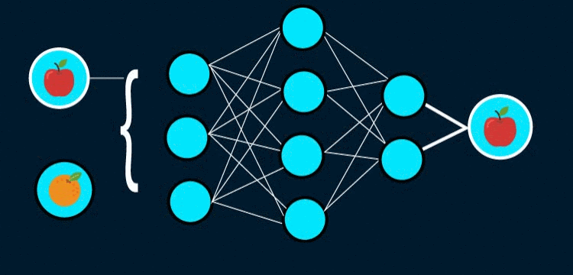
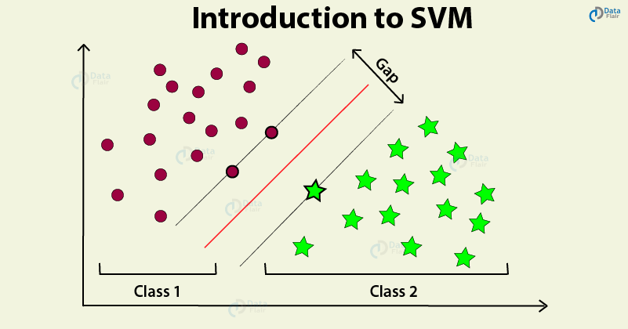
Modeling the Numbers
Support Vector Machine (SVM model)
Neural Network Sequential Model (Sequential model)

Slide 5
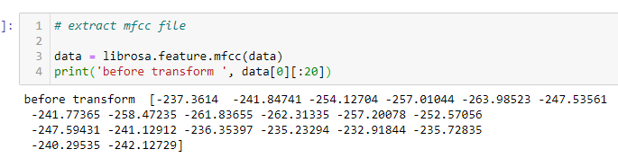
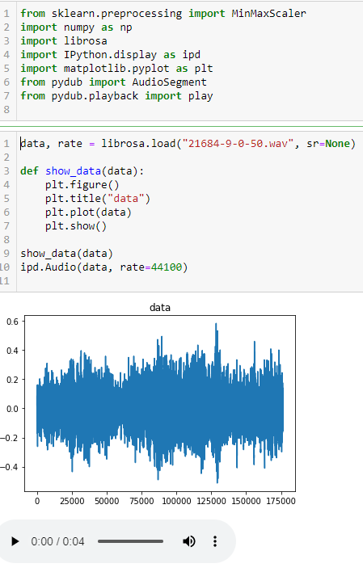
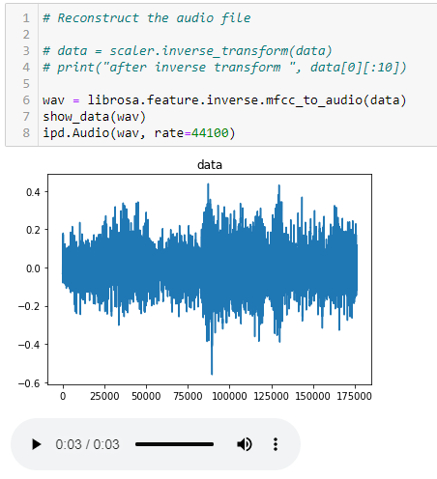

Audio file reconstruct from mfcc values
Step1: Reading audio file (Street Music)
Step2: Extract MFCC values
Step3: Reconstruct the audio file
Original
Reconstruct
Air Conditioner
Car Horn
Dog bark
Gun Shot
Notes:
SO as you can see here in step 1 we imported the audio files into a jupyter notebook using Librosa. Librosa is a python library that implements music information retrieval techniques
In step 2 we conducted the feature extraction which converts the audio into MFC Coefficient values.
In step 3 we reconstructed the sound using the MFC Coefficient values. There are many different types of audio feature extractions but After diving into the literature, we found that MFC Coefficient
values were the best for reconstructing sound for classification.
In fact, it is the feature extraction used for speech identification.
SO for example this is the sound of the car horn...
After reconstructing the sound using MFC coefficient values it sounds like this.
As a second example of a different type of frequency,
This is the sound of the dog bark.....
After reconstructing the sound using the MFC Coefficient values it sounds like this.
Single tone frequencies with higher pitches tend to be easier to classify. This was reflected in
our findings as gunshots had the highest accuracy for both models.
So Next Bill will talk about some of the challenges that we encountered.... So I’ll pass it on to him

Slide 6
Challenges

Slide 7
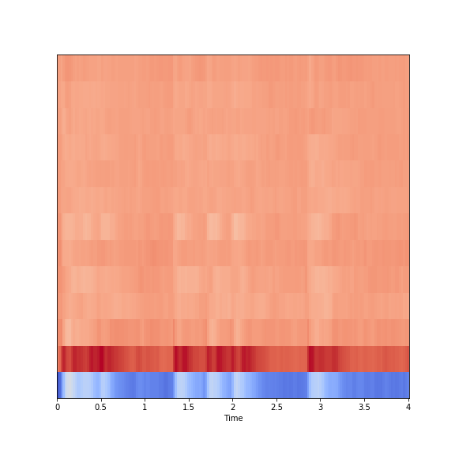
Data processing Challenges
173
MFCCs (Mel-Frequency Cepstral Coefficients)
Well-known sound feature for machine learning
mfcc=librosa.feature.mfcc(signal, sr, n_mfcc)
Sound : dog_bark
Duration : 4 sec
N_mfccs (number of mfccs) = 13
len(mfcc)= 173 = 22050x4 / hop_length(512)
13 x 173 entries or 2249 (flattened)
Spark jdbc : limit for the columns numbers (1600?)
[ [ ], [ ] .. ]
…
[. [], [], .. ]
13
8732
files
Notes:
This will show
Librosa.load – sample rate is 22050
Hop_length is the hop length for stft (short time Fourier transform ) -- number of audio samples between adjacent STFT columns

Slide 8
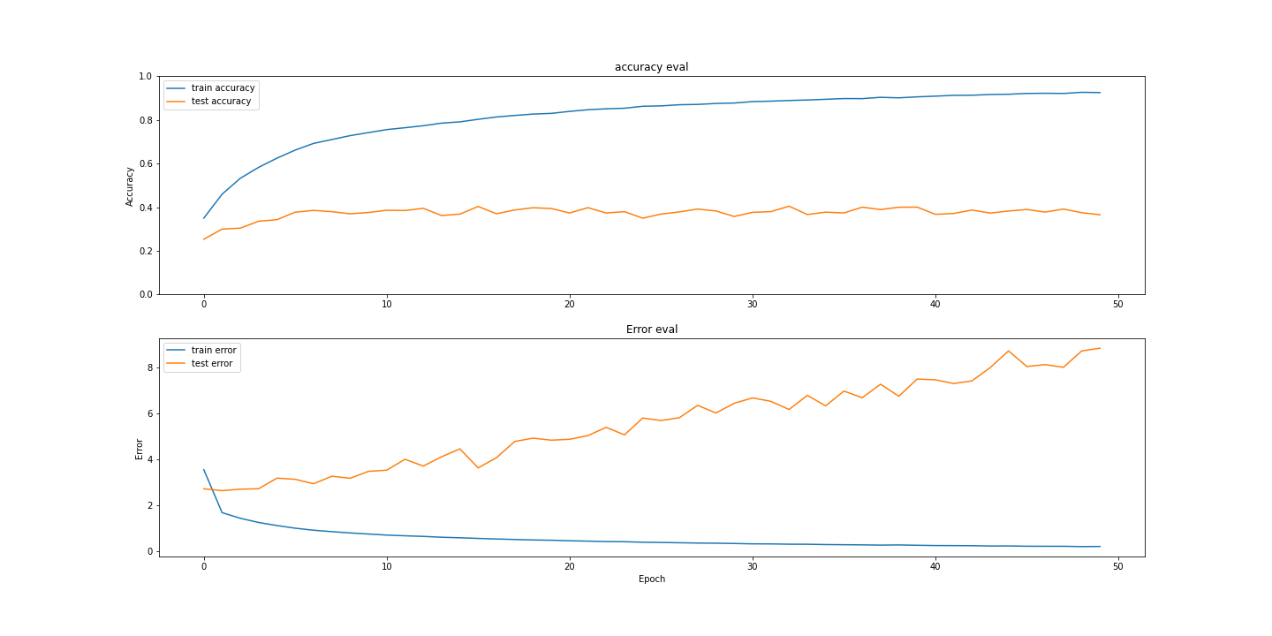
Overfitting
Change the architecture
Adjust the neurons
Adjust the number of layers
Data Augmentation
Increase data input
Apply transformation
reducing vector size
statistics
Early stopping
Drop-out
Randomly drop neurons while training
Increases network robustness
Regularization
Adds penalty to errors
Punish large weights
L1 and L2 concepts

Slide 9
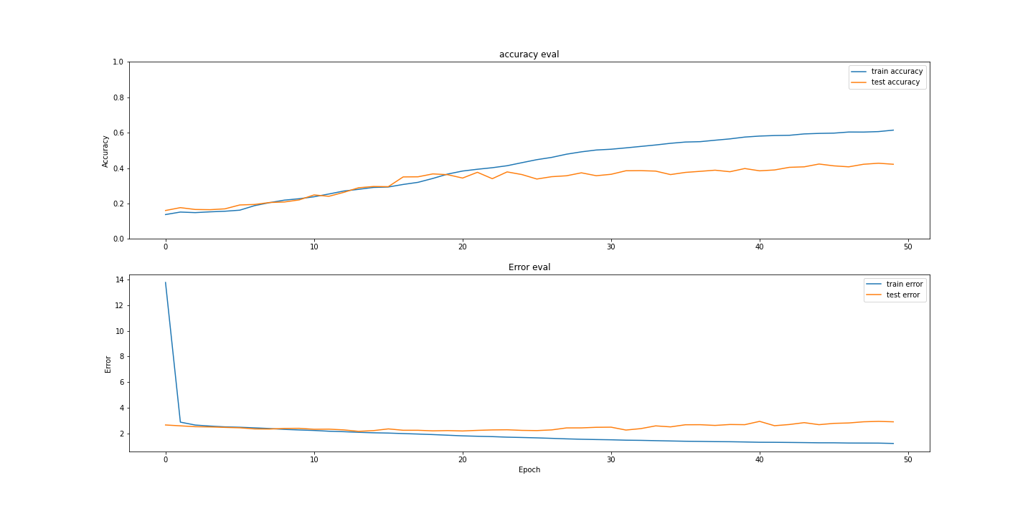
Using Regularizes and Dropping

Slide 10
Data processing

Slide 11
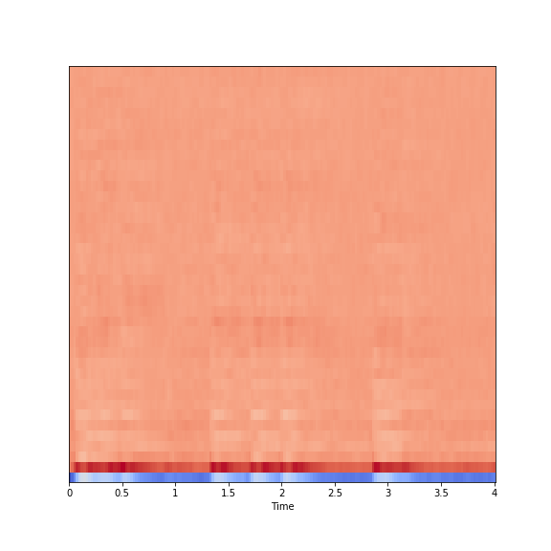
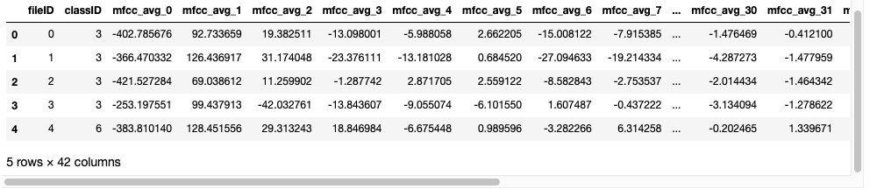
Data processing 1
39th Average( )
[0th Average( ), ,…, 39thAverage( )]₄₀
40
ith Average( )
Experiment 1 input:
Sample size:
8732 rows
40 columns
40 columns
0th Average( )
8732 rows

Slide 12
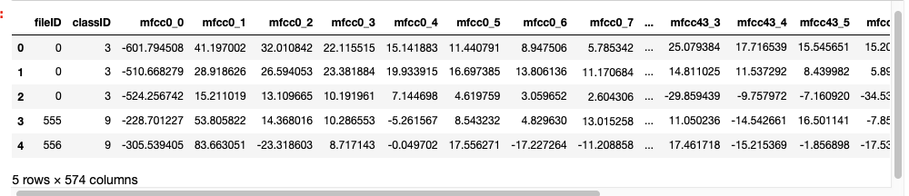
Data processing 2
1 sec : 44 values
Experiment 2 input:
Sample size:
30825 rows
572 columns
[ , , , ]_{44 x 13}
[ , , , ]_{44 x 13}
[ , , , ]_{44 x 13}
[ , , , ]_{44 x 13}
13
572 columns
30825 rows

Slide 13
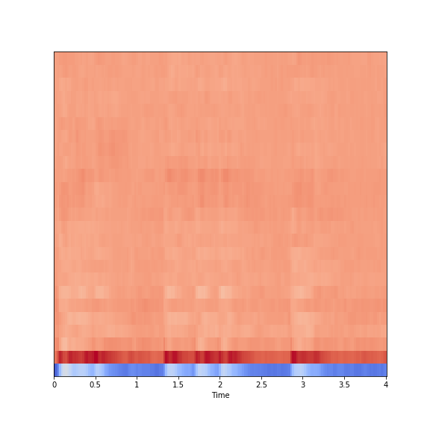
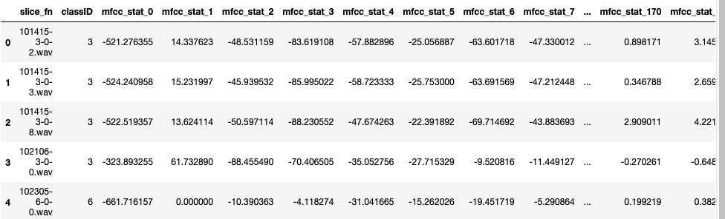
Data processing 3
Statistic functions
[min, …, max, …, mean, … var, … skewedness, … kurtosis, …] ₁₈₀
Statistic functions
min
max
mean
var
skewedness
kurtosis
30
Experiment 3&4 input:
Sample size:
8732 rows
180 columns
180 columns
Statistic functions
8732 rows

Slide 14
Machine learning scenarios

Slide 15
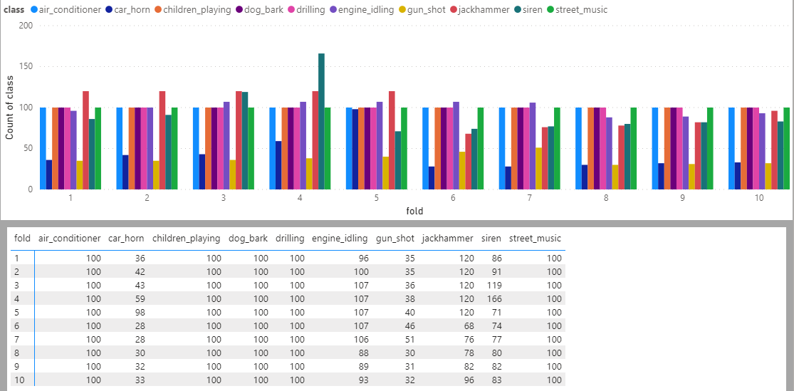
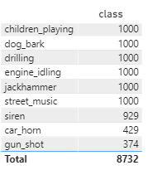
Meta-Data structure
It provides list sound files by class
There are excerpts from one sound file are stored in same folder.
Sound file distribution between 10 folders which will be used for training and testing
Notes:
Meta-Data Structure
This will show how each folder is distributed and for each class ID is distributed amongst 10 folders.
Time duration for each class varies. Is there a way to show this? Does it add any value to understanding this?
Files are

Slide 16
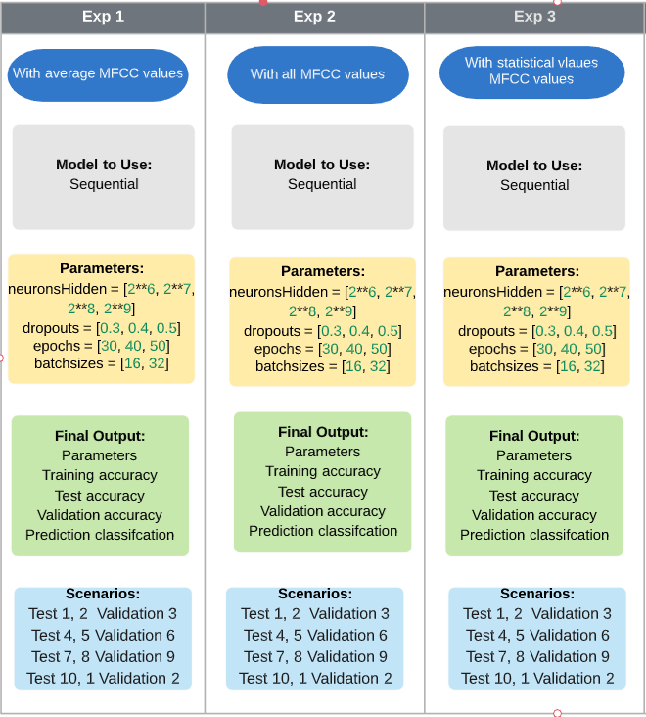
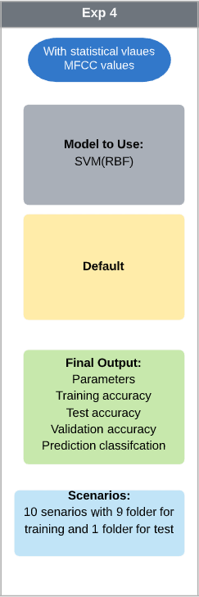
Machine learning Scenarios
List of experiment to identify best parameters for training and testing accuracy
Exp with SVM model

Slide 17
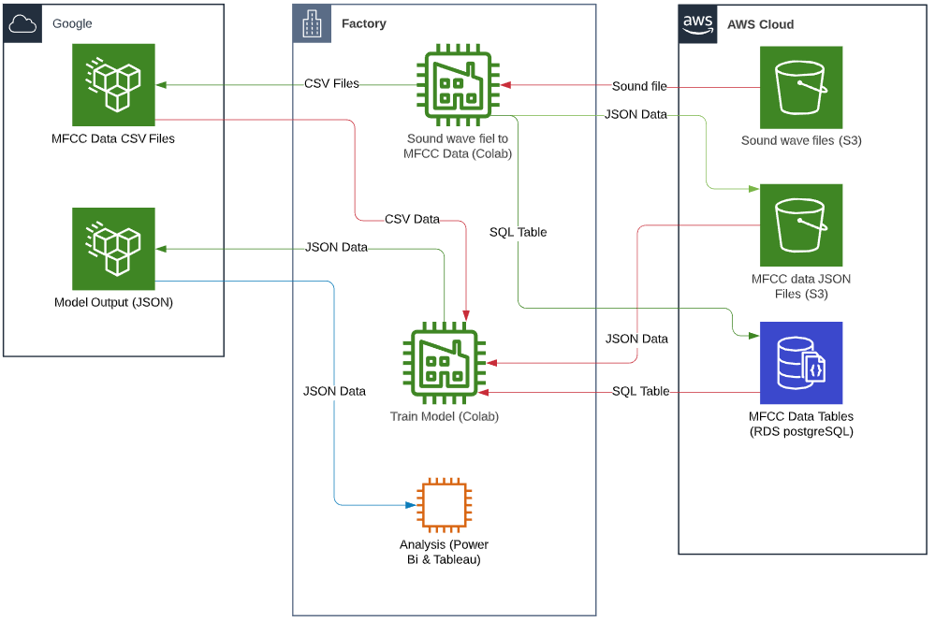
Data flow & transformation

Slide 18
Analysis

Slide 19
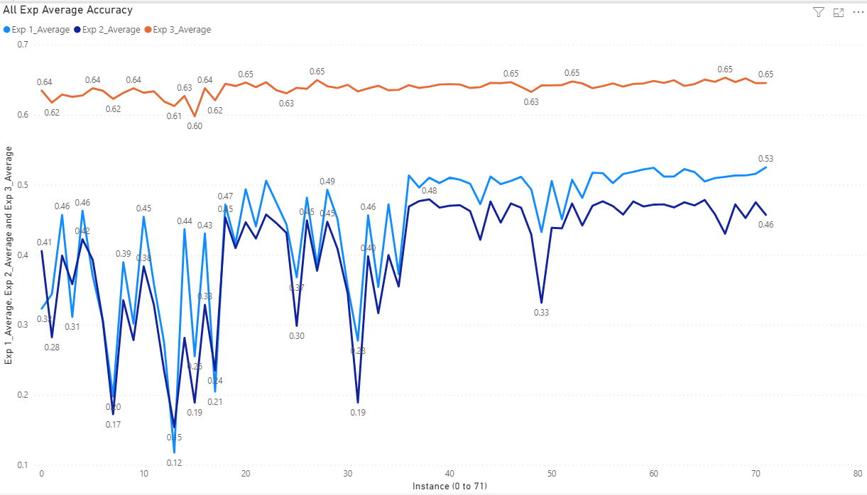
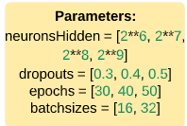
Sequential model Accuracy analysis
X-axis is the instances from 0 to 71
Each instance consist of following parameter:
Neurons
Dropouts
Epochs
Batch sizes
Average of the four scenarios per experiment.
Notes:
Demonstrate how we tested the files.
Show how we configured the different models.

Slide 20
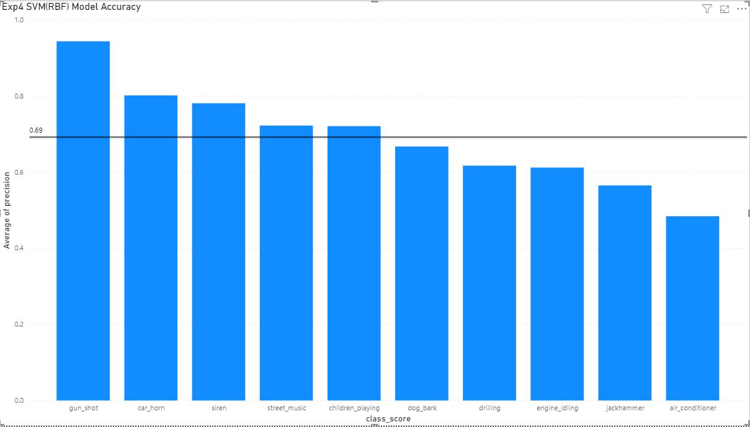
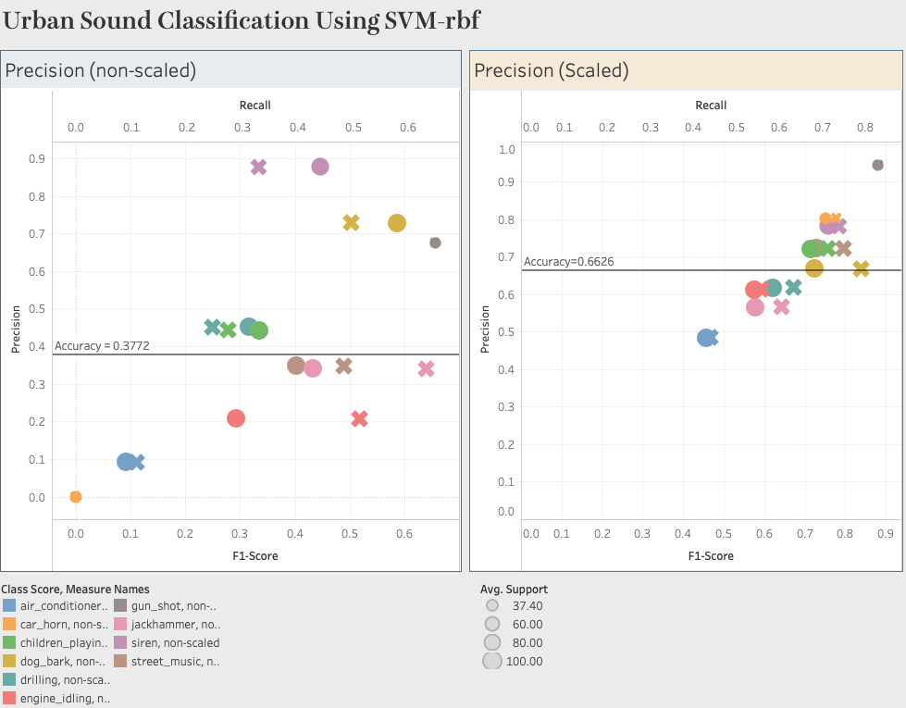
Svm(rbf) model accuracy (Exp4)
Exp4 used default parameter
Non-scaled data accuracy: 0.37
Scaled data accuracy: 0.66
Scaled data provides better accuracy

Slide 21
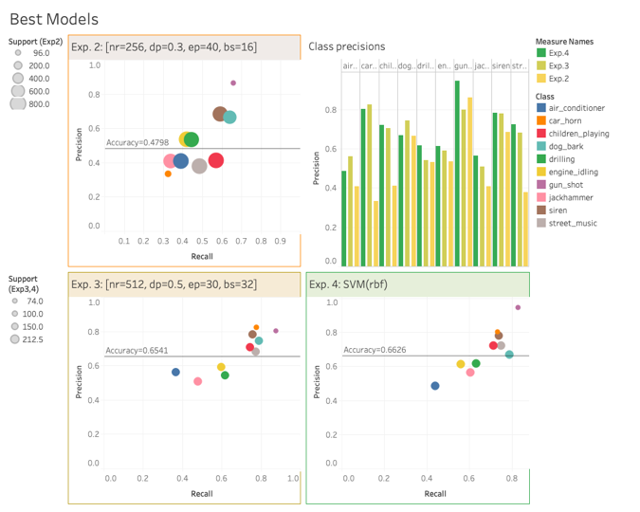
Analysis Conclusion
Best Parameters for sequential
Exp1: nr=512, dp=0.5, ep=50, bs=32
Exp2: nr=256, dp=0.3, ep=40, bs=16
Exp3: nr=512, dp=0.5, ep=30, bs=32
Sequential model Exp3 has the best accuracy
Gun-shot is the most accurate except in Exp3 where car_horn is the best.
Exp3 and Exp4 have similar accuracy value
According to the classification report Exp4 is more reliable model
Notes:
What did we learn?
How to use liberosa
Conversion of analog sound data
Conversion of wav files to MFCC
Usage of S3 and AWS - # of requests – there are limits for the the free tiers so we met the limit quickly
Use Google Colab
Learned the spark to write the SQL database (the maximum limit is 1600)
Point to experiment 4 with pointer when ABBY is at the last line.

Slide 22
Project learning
Technology
Audio
Audio feature
Machine Learning
Sequential Model
Support Vector Machine Model
Librosa library
Google Colab Notebook
Google Drive mount with Colab Notebook
Extracting Audio features
Audio reconstruction from MFCC
Overfitting
Cross validation
Spark
Sklearn
S3 bucket use
RDS PostgreSQL
Notes:
What did we learn?
How to use liberosa
Conversion of analog sound data
Conversion of wav files to MFCC
Usage of S3 and AWS - # of requests – there are limits for the the free tiers so we met the limit quickly
Use Google Colab
Learned the spark to write the SQL database (

Slide 23
acknowledgement
Sound Data
Urban Sound Dataset
URBANDSOUND8K Dataset: https://urbansounddataset.weebly.com/urbansound8k.html
Audio Course
Deep Learning (for Audio) with Python
Youtube vidieo series by Valerlo Velardo:
Sound Concepts
Audio Signal
Urbans Sound Classification Part 1: sound wave, digital audio signal
https://www.youtube.com/watch?v=yWqrx08UeUs&feature=youtu.be
https://towardsdatascience.com/urban-sound-classification-with-librosa-nuanced-cross-validation-5b5eb3d9ee30
Justin Salamon, Christopher Jacoby & Juan Pablo Bello, A Dataset and Taxonomy for Urban Sound Research, 22nd ACM International Conference on Multimedia, Orlando USA, Nov. 2014
https://www.youtube.com/watch?v=fMqL5vckiU0
https://towardsdatascience.com/urban-sound-classification-part-1-99137c6335f9
Urban Sound Classification with Librosa – tricky cross-validation
Sampling, Aliasing & Nyquist Theorem

Slide 24

Thank You
Notes:
Data structure

Slide 25
Back up slides

Slide 26
Drop-out

Slide 27
Drop-out

Slide 28
OverFitting
Change the architecture
adjusting the neurons
adjusting the number of layers
Data Augmentation
Increase data input
Apply transformation
reducing vector size
statistics
Early stopping
Drop-out
Randomly drop neurons while training
Increases network robustness
Regularization
Adds penalty to errors
Punish large weights
L1 and L2 concepts

Slide 29
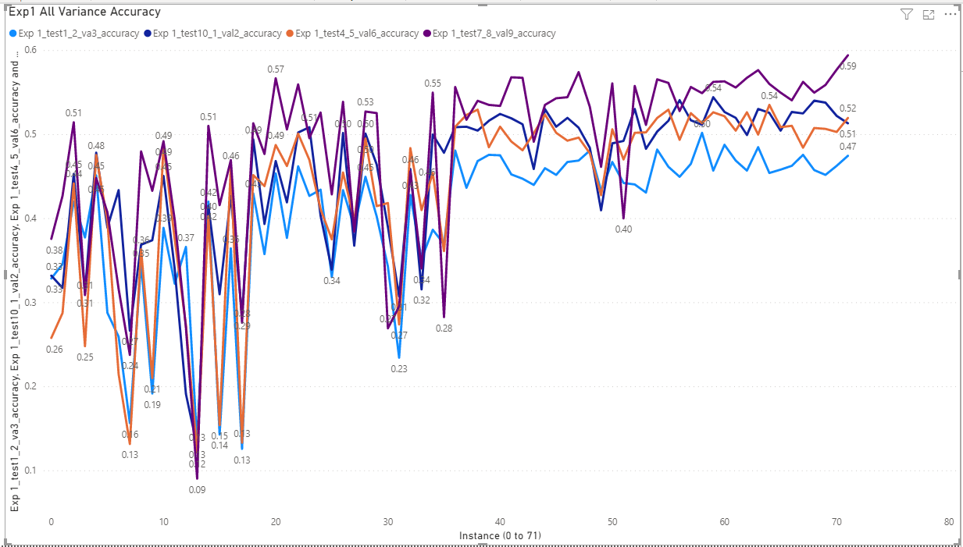
Exp1 Accuracy (all)

Slide 30
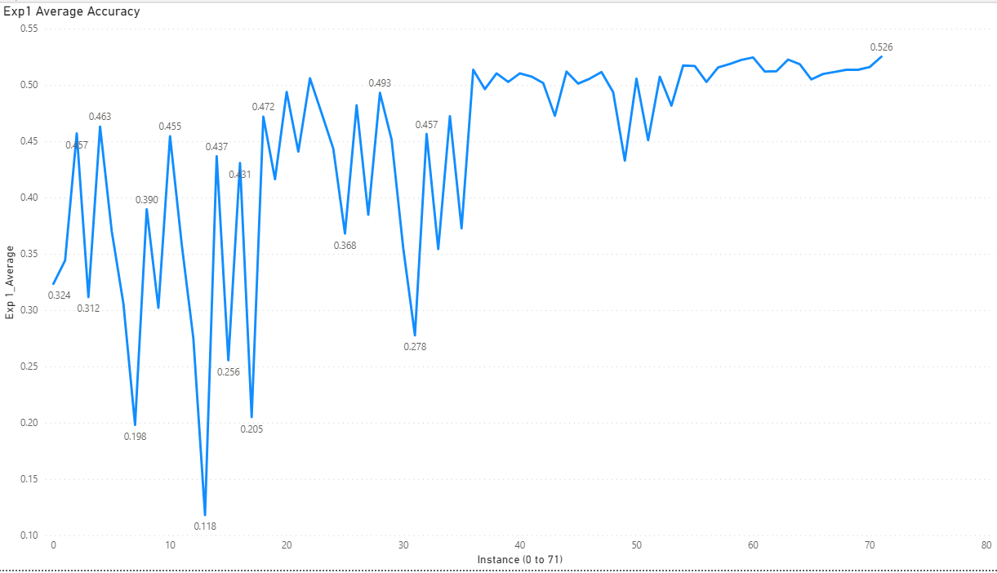
Exp1 Accuracy (avg)

Slide 31
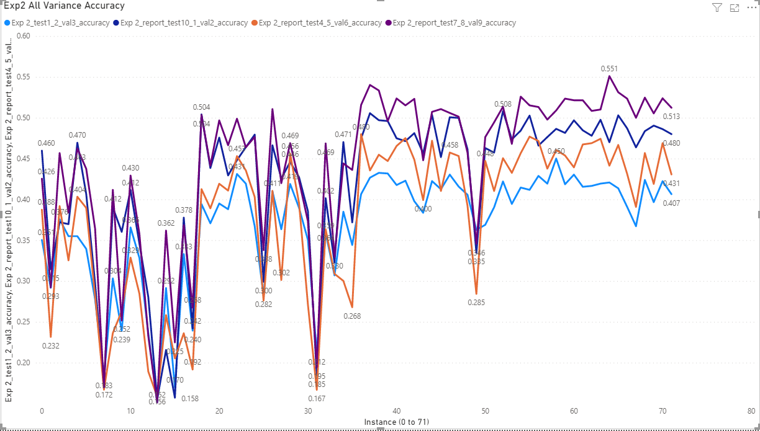
Exp2 Accuracy (all)

Slide 32
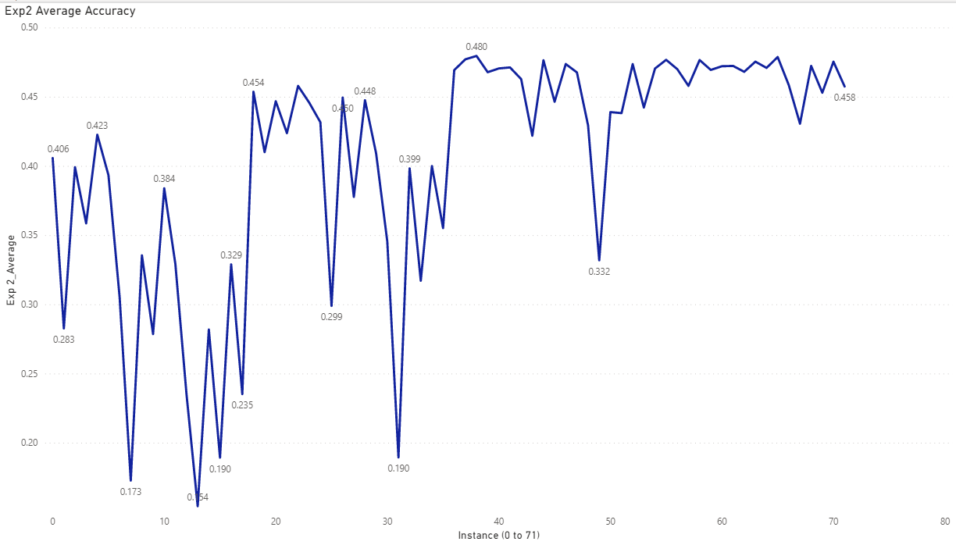
Exp2 Accuracy (avg)

Slide 33
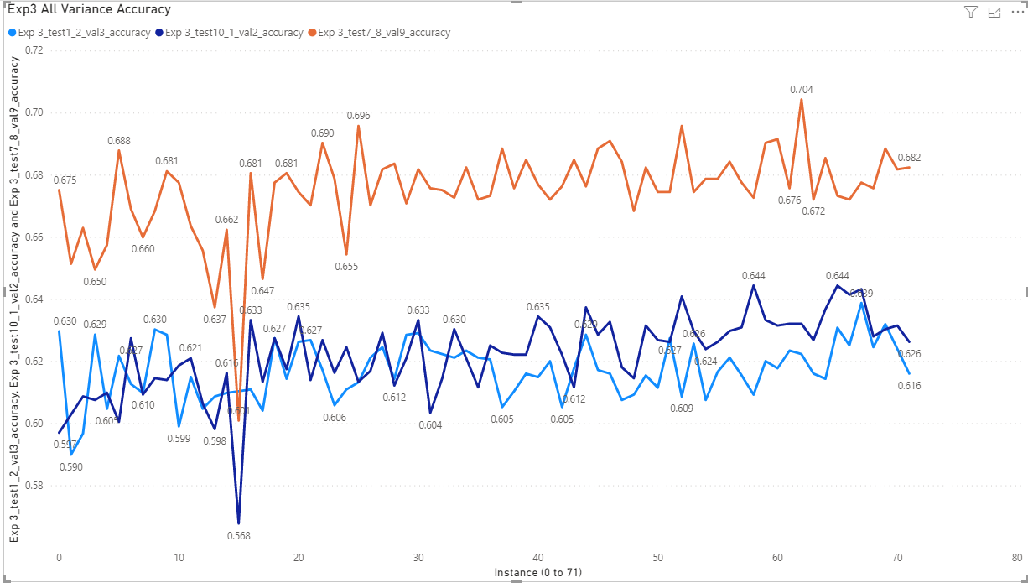
Exp3 Accuracy (all)

Slide 34
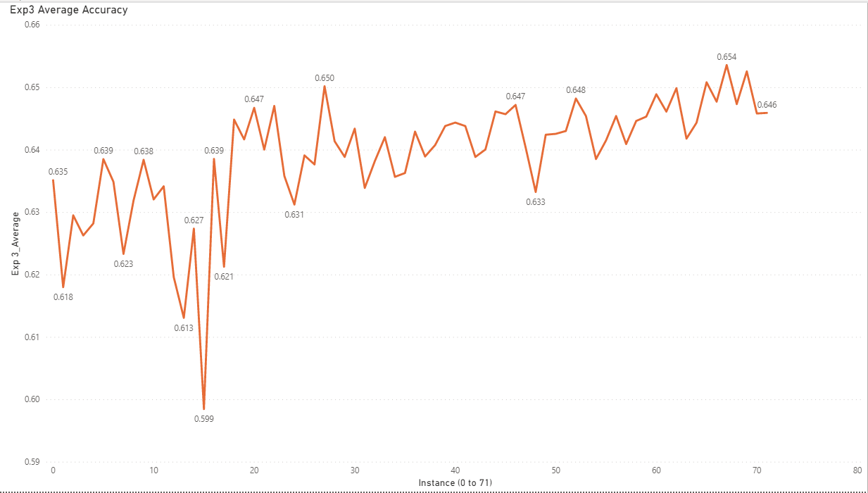
Exp3 Accuracy (avg)

Slide 35
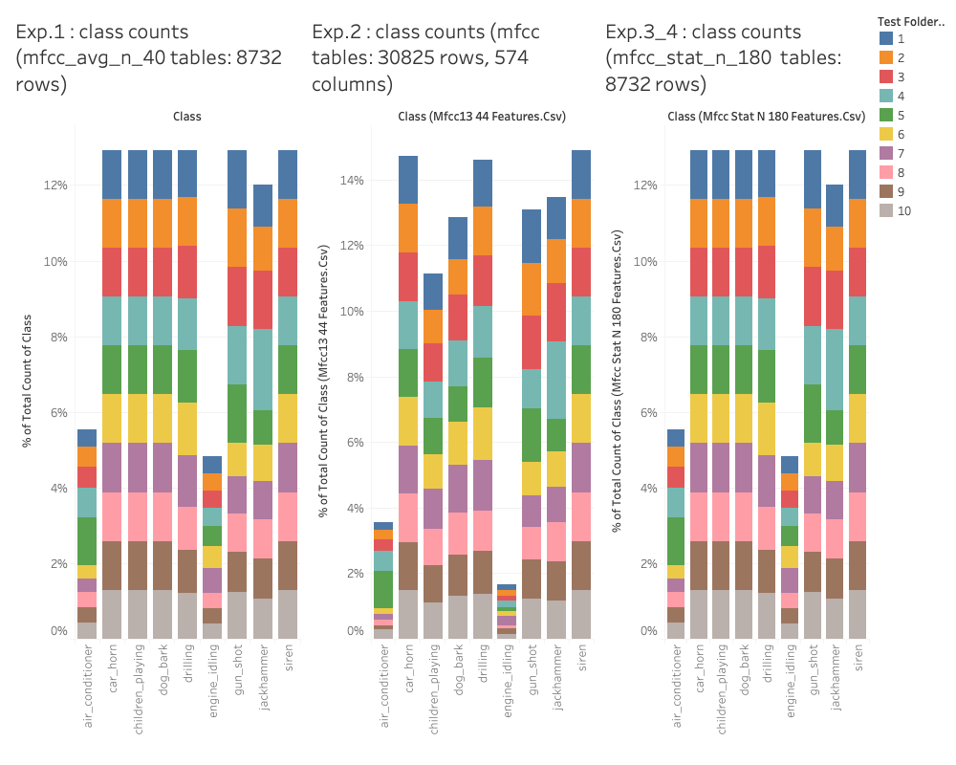
Analysis(Input)
Notes:
Demonstrate how we tested the files.
Show how we configured the different models.

